Slide 1
Strategic Plan Review
Plenary Session of 2023 Forum

Slide 2
COMISS Network
A National Roundtable for pastoral care and counseling
Founded in 1979-1980
Current Member Types
  Credentialing Bodies
  Endorsing Bodies
  Professional Membership Organizations
  Chaplain and Pastoral Counselor Employing Organizations
  Academic and Educational Institutions

Slide 3
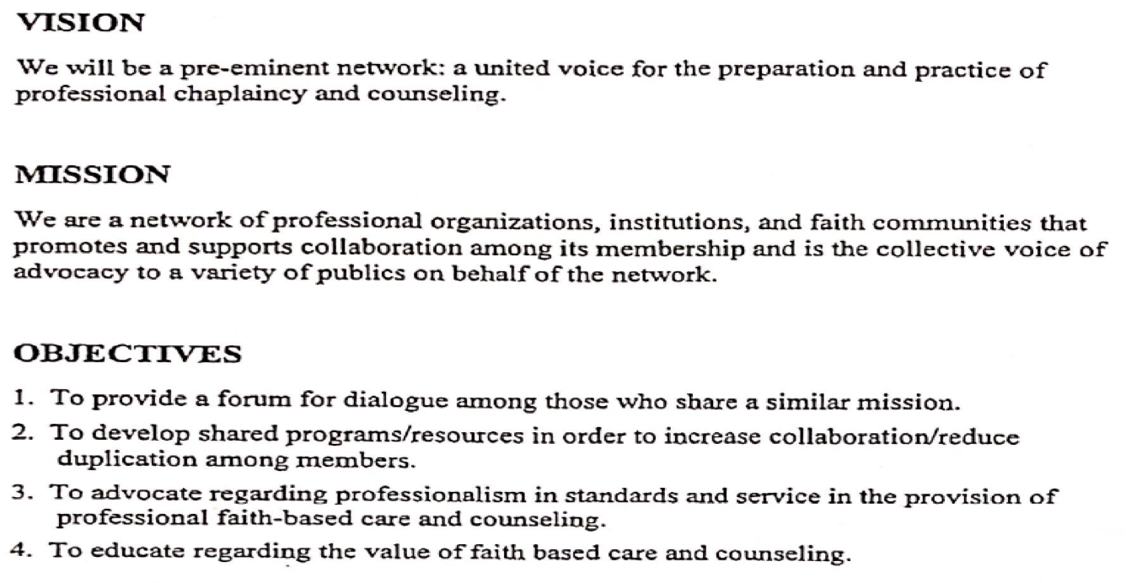
Early Mission/Vision Statement (1999)

Slide 4
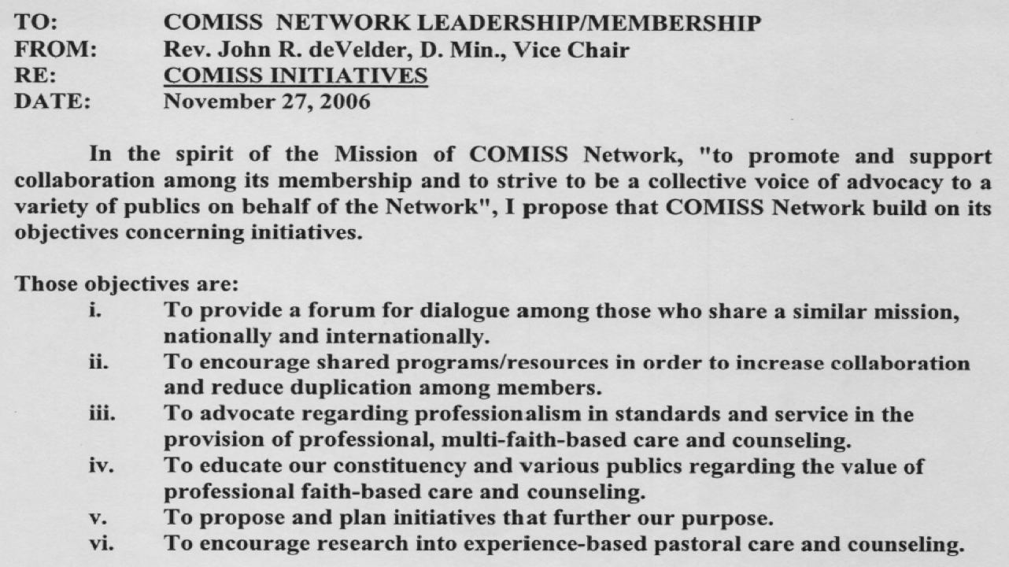
2006 Objectives

Slide 5
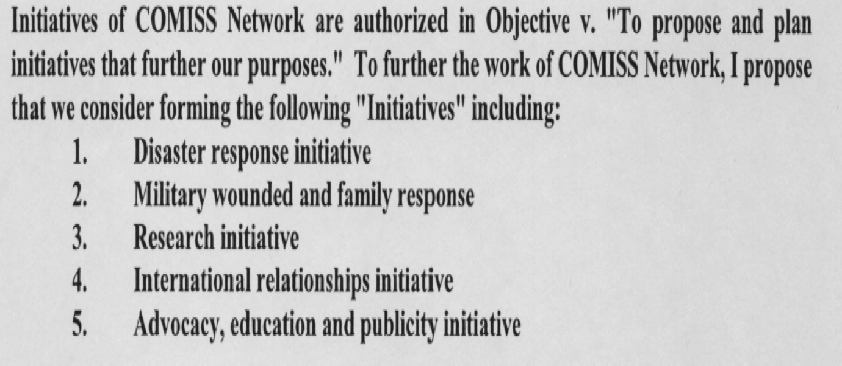
2006 Continued

Slide 6
2018 Strategic Plan
Goal #1: Review and advance the mission and vision of COMISS
Goal #2: Review and revise what constitutes COMISS Leadership
Goal #3: Review and revise COMISS Programs

Slide 7
2018 Objectives: Goal 1
Goal #1: Review and advance the mission and vision of COMISS
Review and determine the sufficiency of current mission and vision statements
Determine the reason we exist and what we are going to do in the future
Develop a glossary for COMISS guidelines
Support and promote research
Promote Advocacy

Slide 8
2018 Objectives: Goal 2
Goal #2: Review and revise what constitutes COMISS Leadership
Review current governance and leadership/board/ volunteer structure
Clarify and revise Board representation (i.e. designated seats on the board)
Clarify and define Executive Administrator role

Slide 9
2018 Objectives: Goal 3
Goal #3: Review and revise COMISS Programs
Review and revise three current programs
Assess COMISS opportunities/profession needs
Develop membership program

Slide 10
Mission and Purpose Statements: Website
Our Mission
COMISS aims to be a pre-eminent network of organizations committed to the preparation and practice of multi-faith spiritual care through chaplaincy and pastoral counseling in specialized settings and promotes and supports collaboration among its members.
Our Purpose
We strive to provide our membership with a unique forum for communication, networking, and advocacy beyond our common calling to pastoral ministry.

Slide 11
Goal 1 Completion
Goal 1: Review and advance mission and vision: not only completed and shared, but new website completed where these statements are visible.
Glossary related to Guidelines: Yet to be completed?
Consensus on Initiatives (from Mission and Vision Statement)
  Review and advance the mission and vision of COMISS
  Review and revise what constitutes COMISS Leadership
  Review and revise COMISS Programs (Forum: 1999, 2006)
  Support and promote research (2006)
  Promote Advocacy (1999, 2006)

Slide 12
Goal 2 Completion
Goal #2: Review and revise what constitutes COMISS Leadership
Review current governance leadership, board and volunteer structure (Guidelines revised)
Develop and define leadership representation from each of the five COMISS membership groups (not completed)
Define the Executive Administrators role and job description (not completed)

Slide 13
Goal 3 Completion
Task Forces were to be developed for each of: CCAPS, Spiritual Care Week, and Forum: Though these were not completed, CCAPS has had standards revised. Our recent pandemic has negatively impacted sustained focus on strategic plan. Budgetary impacts have also exerted influence re: FORUM.
Assess COMISS opportunities/profession needs: Called for a task force of insiders and outsiders to develop and conduct a survey in this area. (Not completed)
Develop membership program
Create board task force to investigate association membership strategies and recommend membership model possibilities (Not completed)

Slide 14
Nov. 2017 Survey Question Responses: CCAPS
How important is CCAPS (COMISS Commission on Accreditation of Pastoral Services) to your organization/constituency?
NOT IMPORTANT to Very Important Weighted average 2.48. 1/3 indicated not important, other 2/3 spread up to very important

Slide 15
Nov. 2017 Survey Question Responses: SCW
Question related to the value of spiritual care week
NOT IMPORTANT to Very Important Weighted average 3.3. Bulk of answers beyond not important to very important
Please explain your response.
Most comments related to importance of highlighting spiritual care week.

Slide 16
Nov. 2017 Survey Question Responses: FORUM
How important is the annual COMISS Forum to your context?
NOT IMPORTANT to Very Important Weighted average 3.6. 1/3 of responses indicated very important, 2/3; another nearly 50% mid-range
Please explain your response:
  Characteristic entry: Again, fellowship, networking and education opportunities are provided through the Forum meeting and this is vital to us.

Slide 17
COMISS in Coming Years: For Discussion Today
Where would you like to see the time and energy of COMISS focused in coming years? Please rank 1 (highest)-8 (lowest). Scores 1-10
Advocacy for chaplaincy…and with government officials 6
Networking between organizations 6
International chaplaincy development 2.5
Greater integration between endorsers and associations 5
Stronger presence of theological/religious schools 3.5
Specific focus areas for 1-3 years 3.5
Greater support/engagement with spiritual care research 6+
Broaden base by inviting spiritual directors, affiliated associations or others 3.5

Slide 18

Further Discussion Today…

